Slide 1



Poverty and Social Exclusion Policies in the UK
Dr David Gordon
戈登 大卫/戴维
Professor of Social Justice
School for Policy Studies
University of Bristol
Public Seminar
Is Japan an Equal Society? Policies against P&SE
Keio University
Tokyo
7th January 2012

Slide 2
All cultures have a concept of Poverty & Exclusion
“In Wealth, many friends, in poverty not even relatives”
- Japanese Proverb
“Poverty is the worst form of violence!”
- Mahatma Gandhi - Indian Philosopher & Freedom Fighter
“The greatest evils and the worst of crimes is poverty”
George Bernard Shaw - Irish Playwright & Novelist

Slide 3
Child Poverty in the UK
The UK Government is committed to tackling the problem of child poverty. In March 1999, the Prime Minister Tony Blair set out a commitment to end child poverty forever:
“And I will set out our historic aim that ours is the first generation to end child poverty forever, and it will take a generation. It is a 20-year mission but I believe it can be done.
The Child Poverty Act 2010 has placed this policy commitment into UK law

Slide 4
UK Child Poverty Act 2010
Places in legislation the commitment to eradicate child poverty by 2020, this means that UK Secretary of State will have a duty to meet the following child poverty targets:
  Relative poverty: Less than 10% of children living in relative low income poverty by 2020.
  Material Deprivation: Less than 5% of children living in combined material deprivation and low income.
  Absolute low income: Reduce the proportion of children who live in absolute low income to less than 5%.
  Persistent Poverty: percentage of children living in relative poverty for three out of four years (target level to be set by the end of 2014 as data are currently unavailable)
Requires the UK Secretary of State to publish a UK child poverty strategy, which must be revised every three years.

Slide 5
The idea that poverty can be ended is over 200 year old
The French enlightenment philosopher Marie Jean Antonine Nicolas de Caritat, Maquis de Condorcet argued in Sketch for a Historical Picture of the Progress of the Human Mind (published posthumously in 1794 by the government of the new French Republic) that poverty was not a result of natural laws or divine will but was caused by ‘the present imperfections of the social arts’
He argued that poverty could be ended by the universal provision of pensions, grants to the young, sickness benefits and state education

Slide 6
European Union definitions of poverty and social exclusion
On the 19 December 1984, the European Commission defined ‘poverty’ as:
“the poor shall be taken to mean persons, families and groups of persons whose resources (material, cultural and social) are so limited as to exclude them from the minimum acceptable way of life in the Member State in which they live.” (EEC, 1985).
This is a relative definitions of poverty in that it refers to poverty not as some ‘absolute basket of goods’ but in terms of the minimum acceptable standard of living applicable in a Member State and within a person’s own society.

Slide 7
Indirect Vs Direct Definitions of ‘Poverty
Process | Lack of Resources | Exclusion for Minimum Way of Life
Townsend (1954, 1962) Interpretation | Poverty | Outcome of Poverty
Ringen (1988) Interpretation | Cause of Poverty | Poverty

Slide 8
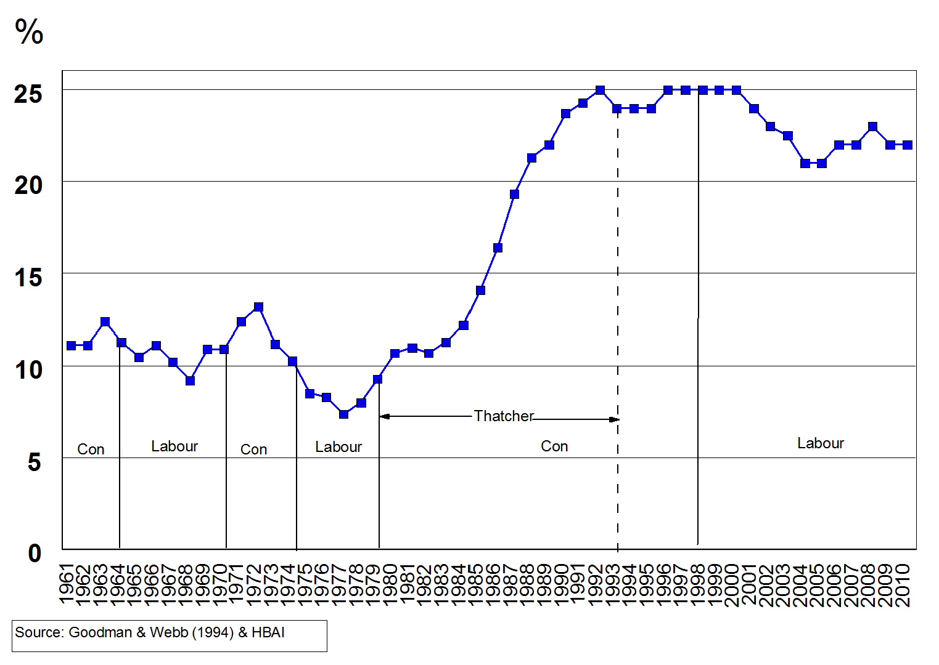
Low Income Households 1961 -2010 (At Risk of Poverty)

Slide 9
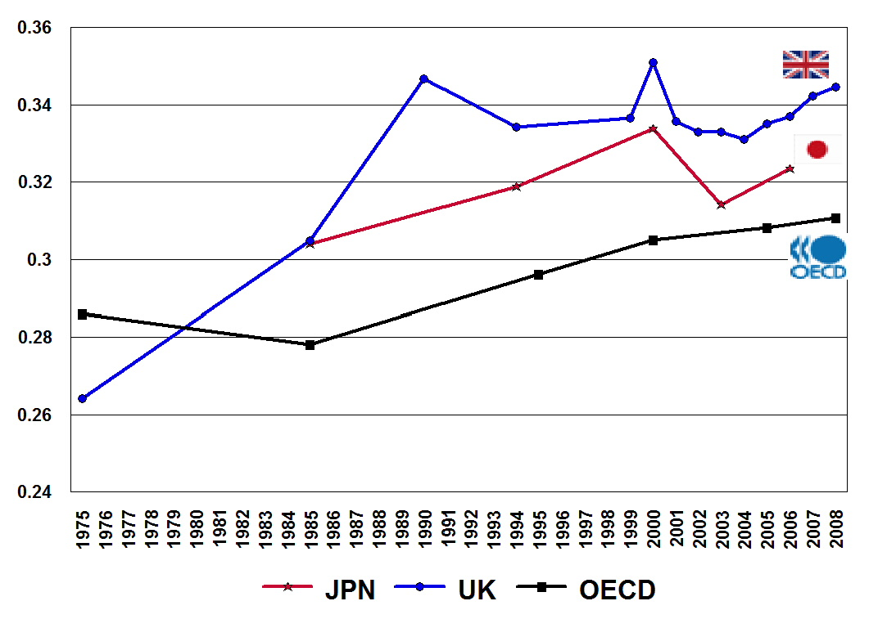
Income Inequality Remains High and is Increasing in Japan & the UK
Source: OECD (2011) Divided We Stand: Why Inequality Keeps Rising

Slide 10
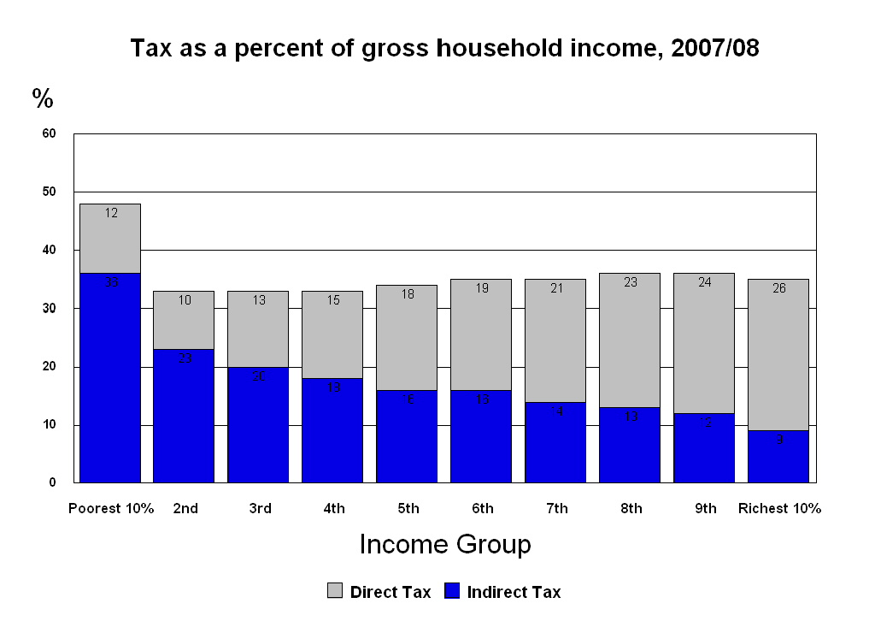

Slide 11
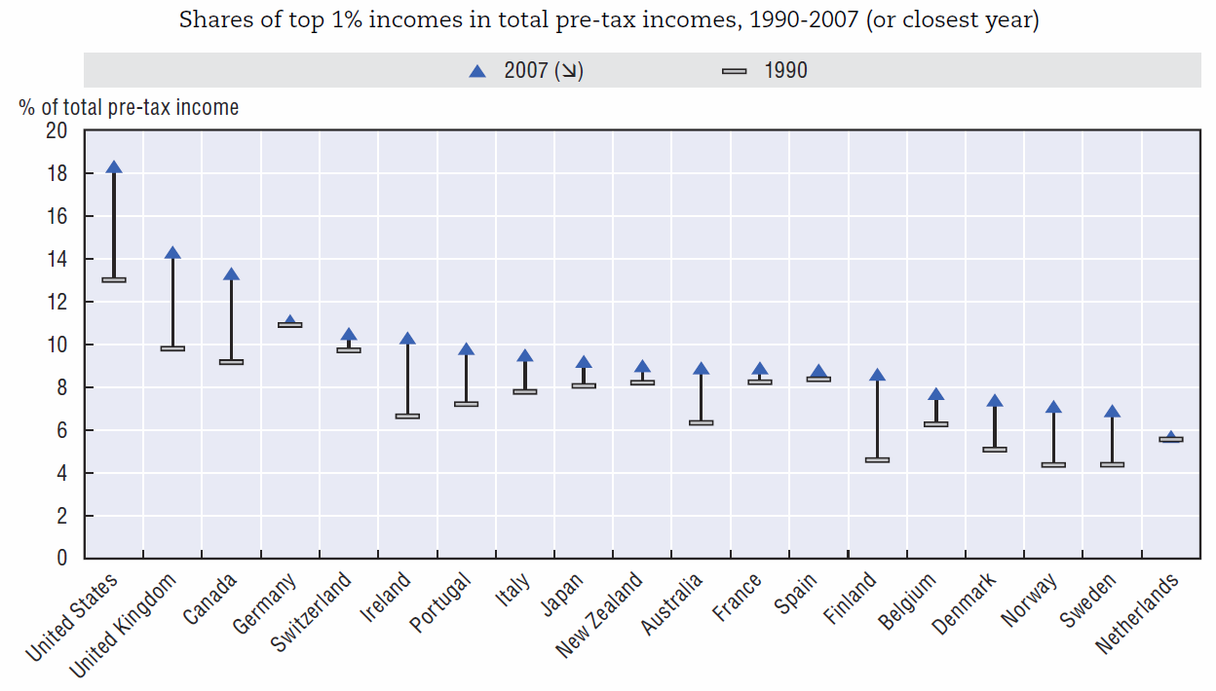
The Income Share of the Top 1% in the UK is Very large and Increasing
Source: OECD (2011) Divided We Stand: Why Inequality Keeps Rising

Slide 12
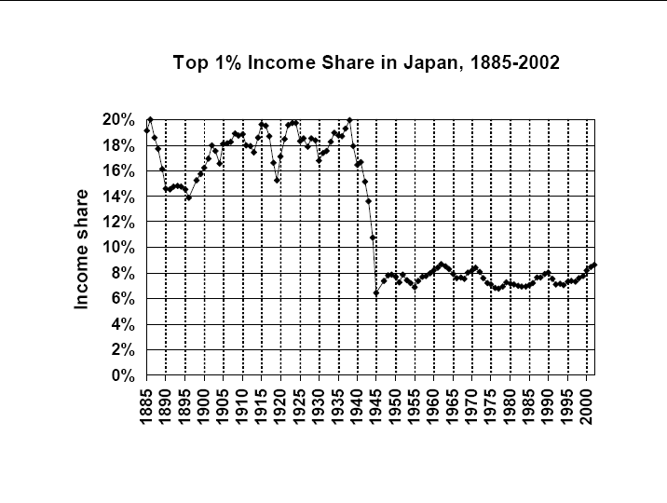
Source: Moriguchi & Saez (2005) http://www.esri.go.jp/jp/workshop/050914/050914moriguchi_saez-1.pdf

Slide 14
A Brief History of Anti-Poverty Policy

Slide 15
The idea that poverty can be ended is over 200 year old
The French enlightenment philosopher Marie Jean Antonine Nicolas de Caritat, Maquis de Condorcet argued in Sketch for a Historical Picture of the Progress of the Human Mind (published posthumously in 1794 by the government of the new French Republic) that poverty was not a result of natural laws or divine will but was caused by ‘the present imperfections of the social arts’
He argued that poverty could be ended by the universal provision of pensions, grants to the young, sickness benefits and state education

Slide 16
Historic changes in the primary purpose of anti-poverty policy
Century | Purpose of Anti-poverty Policy
17th & 18th | Relief of Indigence
19th & early 20th | Relief of Destitution
20th | Alleviation of Poverty
21st | Eradication of Poverty

Slide 17
UK Policy Context
17th & 18th Century: Poverty was perceived as a regrettable but necessary evil that was required to make the ‘lower classes’ work. Young (1771) argued that “Everyone but an idiot knows that the lower classes must be kept poor or they will never be industrious”. It was widely believed that without the fear of poverty people would not work and there would be no prosperity or civilisation.
19th Century: The able-bodied pauper and his family were denied their liberty, civil rights and basic human dignity order to compel behavioural change. Poverty was perceived to purely result from ‘fraud, indolence and improvidence’ and not from any structural factors such as the unavailability of work.
20th Century: Welfare State - Poverty mainly seen to be caused by structural factors e.g. unemployment, sickness, etc. Benefits and services to provide safety nets in the short term to alleviate poverty. Full employment for long term economic well-being.
21st Century: The concept of freedom from poverty and hunger as a human basic right. Sufficient resources to participate fully as a citizen

Slide 18
The Present Day Context

Slide 19

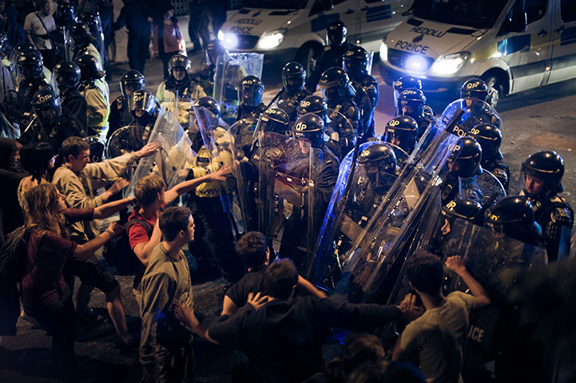
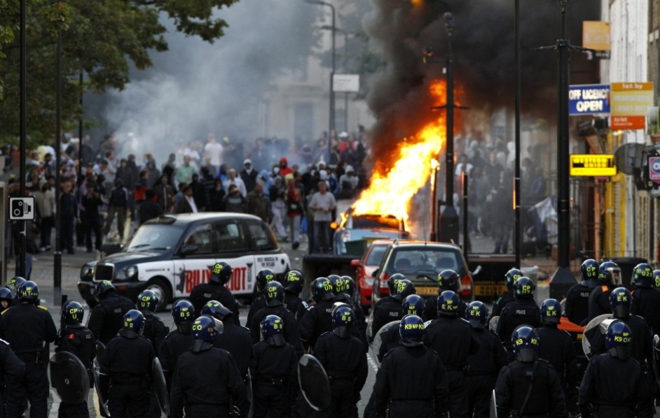
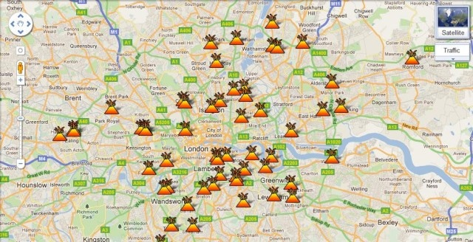
England Civil Unrest (‘riots’) 2011

Slide 20
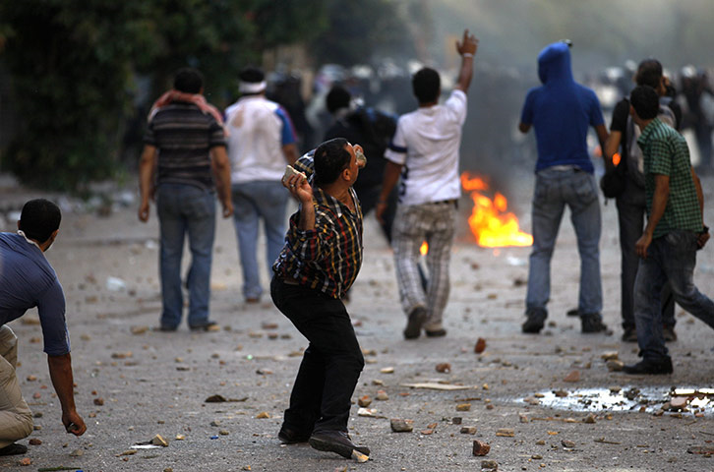
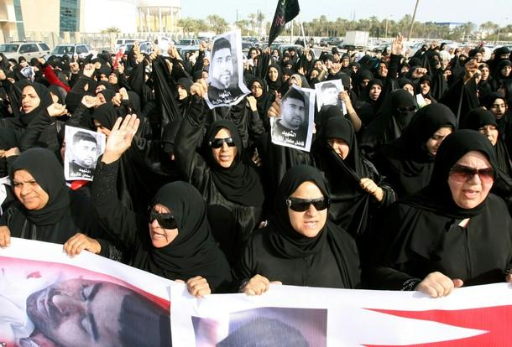

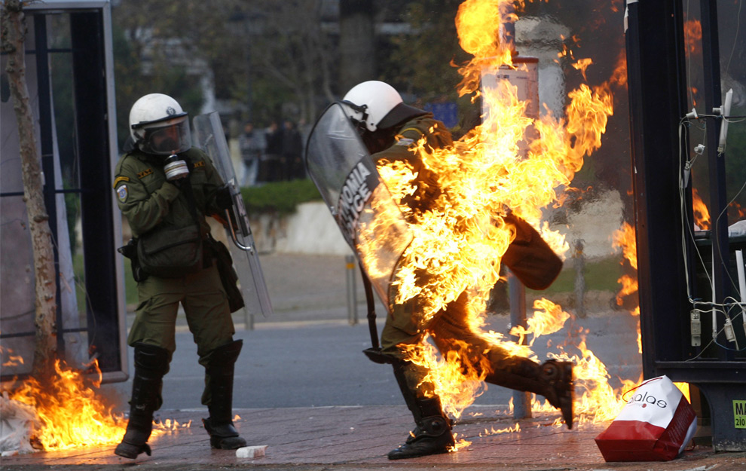
Europe & Middle East Civil Unrest, 2011
Bahrain
Egypt
Greece
Spain

Slide 21
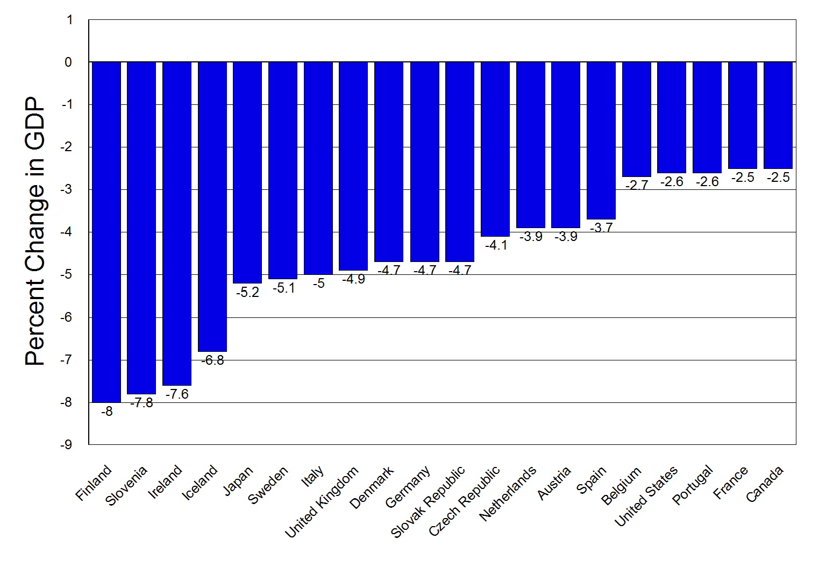
The Effects of the Global Economic Crisis
Source: IMF - 2009 GDP Change

Slide 22
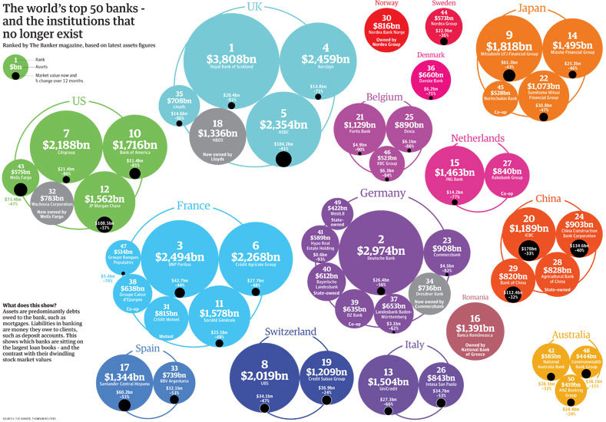
http://www.guardian.co.uk/news/datablog/2009/mar/25/banking-g20

Slide 23
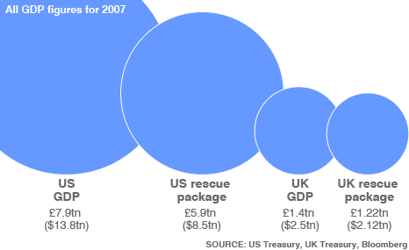
The Scale of the Financial Rescue in the USA & UK
The bank’s profits were private but the losses belong to the public!
http://news.bbc.co.uk/2/hi/business/7893317.stm

Slide 24
Lessons from the UK Experience of Anti-poverty and Social Inclusion Policies

Slide 25
Child Poverty has a lot bad outcomes
Outcome
Mortality
Morbidity
Accidents
Mental Illness
Suicide
Child Abuse
Teenage Pregnancy
Environment/Housing Conditions
Homelessness
Low Education attainment
School exclusions
Crime
Smoking
Alcohol
Drugs
Child Labour
Are Outcomes Associated with Poverty?
Yes, strong association with social class
Yes, strong association for most diseases
Yes, for fatal accidents (but not accident morbidity)
Yes
Yes
Yes, except sexual abuse
Yes
Yes
Yes
Yes
Don’t Know
No
Mainly after childhood
No
No
No
Source: Bradshaw (2001)

Slide 26
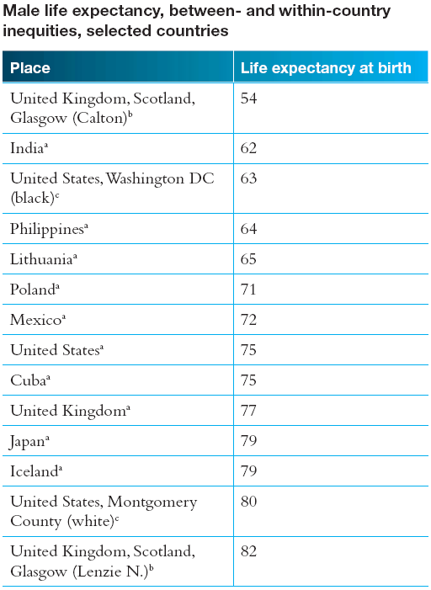

Slide 27
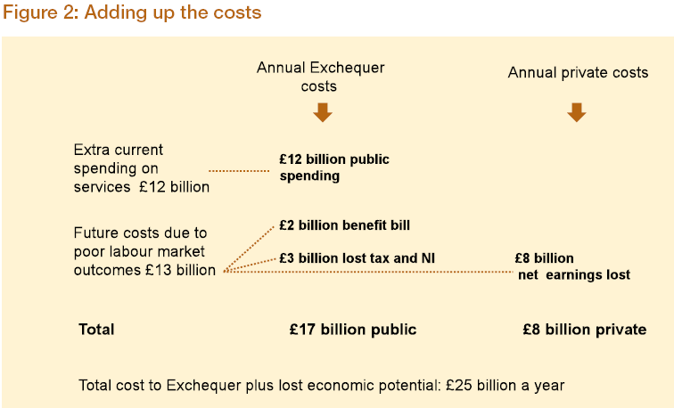
Child poverty is very expensive
It is makes good economic sense to get rid of it

Slide 28
New Labour and Poverty and Social Exclusion Policies
The 1997 New labour Government was elected with a firm commitment to reduce poverty and exclusion. In 1996, Tony Blair argued that;
“for the new Millennium we need a war on exclusion and a determination to extend opportunity for all” (January, 1996) and also “If the next Labour government has not raised the living standards of the poorest by the end of its time in office, it will have failed” (July, 1996)
Within months of being elected Social Exclusion became an important Government concept. In August 1997, the Social Exclusion Unit (SEU) was launched by Peter Mandleson who argued that the;
“Scourge and waste of social exclusion” were “the greatest social crisis of our time” (Mandelson, 1997)
The SEU’s job was to coordinate policy across government departments and work with local authorities and the voluntary sector.

Slide 29
A Focus on Child Poverty and Exclusion
The New Labour Government developed social inclusion policies across broad areas, such as tackling health and educational inequalities and also focused on specific target groups e.g. poor neighbourhoods, services for older people and pensioner incomes, vulnerable groups and exclusion and poverty amongst ethnic minority groups.
However, there developed an increasing focus on child poverty and increasing the opportunities of poorer children.
There was a strong emphasis on tackling exclusion and child poverty by increasing paid employment and making it pay

Slide 30
Making Work Pay & Increasing Incomes of Families with Children
National Minimum Wage
New Deal for Lone Parents
Working Tax Credit
Child Tax Credit
Increased Child Benefit (for first child)
Increased length and amount of Maternity Allowance
Sure Start Maternity Grant
Increased Income Support Allowance for younger children
Expansion of Nursery School Provision for 3 and 4 year olds
Sure Start for young children in poor areas (20% most deprived areas)
National Childcare Strategy to deliver high quality, affordable childcare everywhere

Slide 31
Sure Start
Focus on young children (Early Years) as this was a “Policy Free Zone” with few vested interests within government departments or any long history of failure which needed to be defended. Driven by the Treasury (Norman Glass) and interventions were to be ‘evidence based’.
Two generational: involving parents and children
Non-stigmatising: avoiding labelling ‘Problem Families”
Multifaceted: Targeting a range of factors not just education or health or parenting
Persistent: lasting long enough to make areal difference
Locally Driven: based on consultation and involvement of parents and local communities
Culturally Appropriate and sensitive to the needs of parents
(Glass, 1999; Eisenstadt, 2011)

Slide 32
Sure Start
The original idea was that Sure Start would be ‘Nurturing’, helping and supporting mothers to bring up their babies/young children. The focus shifted to childcare, education and helping parents to get paid work.
Sure Start was very popular with the public and politicians and expanded rapidly (faster than the civil servants wanted!)
1999/2000 £80 million
2000/2001 £184 million
2001/2002 £284 million
2002/2003 £449 million
2003/2004 £449 million
After 2004/05 Sure Start went from being 500 Children’s Centres targeted in the poorest areas to a Universal service with 3,500 centres throughout the country. Sure Start was one of the few services designed for the ‘poor’ where the ‘rich’ actively worked to get access

Slide 33
Sure Start – Did it Work?
Sure Start became to be seen by Ministers as a means to an end (e.g. getting parents into paid work) rather than a social good in its own right (e.g. early education and nurturing)
Impact Evaluation Findings (2005, 2008, 2010)
Compared outcomes for children in Sure Start areas with a matched sample of children from a national survey (Millennium Cohort) .
Effects for children - better health and fewer obese young children – BUT no other significant effects!
Effects for Parents – greater life satisfaction, better parenting, more stimulating and less chaotic home environment for children and an increase in paid work by parents BUT mothers were also less likely to attend school meetings and were more likely to report depression.
So Sure Start was very good for parents (particularly mothers) but had limited impact on young children particularly their cognitive development and education

Slide 34
What was achieved?
Established the importance of services for young children – this idea is no longer contested in the UK.
Extended the right to publically funded early education and childcare services.
Established Sure Start Children’s Centres as the place parents go for advice and support i.e. Sure Start is a good ‘brand’.
Developed a service that is very popular with parents.
(Eisenstadt, 2011)

Slide 35
Welsh Child Poverty Strategy: The first of many
Increasing the income of poor families with children.
Ensure that, as far as possible, children living in low income families are not materially deprived.
Promote and facilitate paid employment for parents in low-income families.
Provide low-income parents with the skills needed to secure employment.
Help young people take advantage of employment opportunities.
Support the parenting of children.
Reduce inequalities in educational attainment between children and young people.
Help young people participate effectively in education and training.
Reduce inequalities in health between children and between their parents, so far as necessary, to ensure children’s well-being.
Reduce inequalities in participation in cultural, sporting and leisure activities between children and between children’s parents, so far as necessary, to ensure children’s well-being.
Help young people participate effectively and responsibly in the life of their community.
Ensure that all children grow up in decent housing.
Ensure that all children grow up in safe and cohesive communities.

Slide 36
Why is Poverty & Social Inclusion Policy Important for Japan?

Slide 37
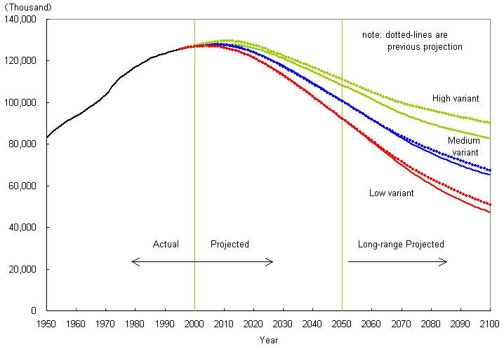
Population Change in Japan: 1950 to 2100
NIPSSR (2004) Population Projections for Japan,: 2001 to 2050
http://www.ipss.go.jp/pp-newest/e/ppfj02/top.html

Slide 38
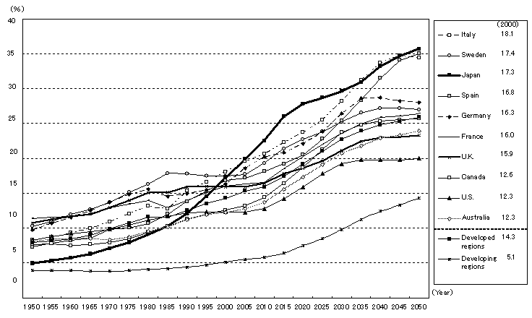
Percentage of the Elderly in the World

Slide 39
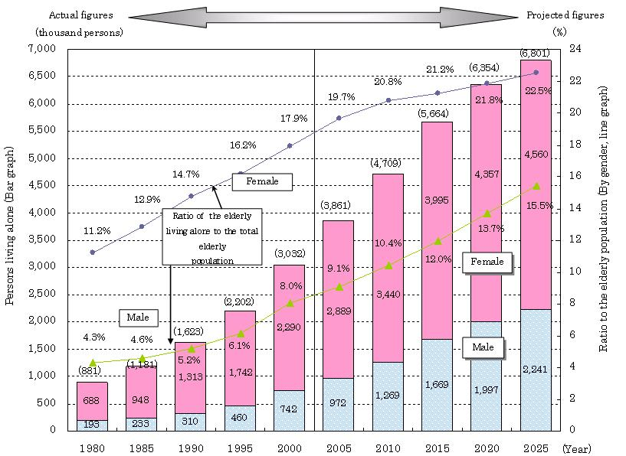
Projected trends in the Elderly Living Alone in Japan

Slide 40
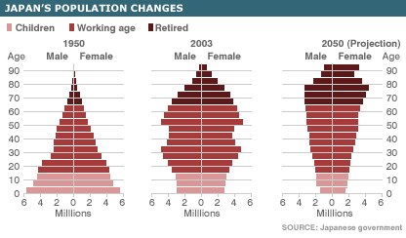

Slide 41
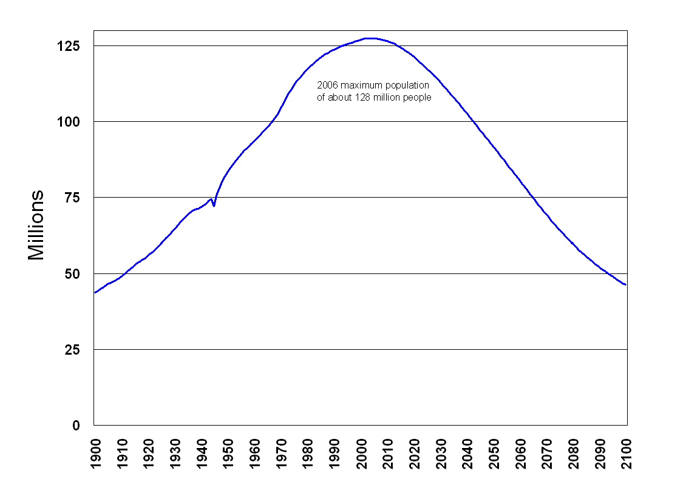
Japan – Potential Population Change 1900 to 2100
Source: Japan Statistics Bureau & NIPSSR (2002) Population Projections for Japan

Slide 42
The Future of Japan’s population?
In 2004, over 1 million people in Japan were aged 90 or over.
In 2005, Japan became the oldest society in human history
In June 2006, Japan’s population is predicted to reach its maximum size of about 128 million people.
In 2007, Japan’s population is projected to begin falling
If current trends continue by 2100 the population of Japan will be between 40 to 45 million people – about the same size as in 1900

Slide 43
Policy Options for Japan

Slide 44
Possible Policy Options
Do nothing – result likely increasing poverty and eventual extinction of the Japanese nation if current trends continue
Increase inclusion of Women and change social attitudes so that men spend less time at work and more time caring for children and doing housework
Make having children more affordable – pro natalist policies
Increased immigration.

Slide 45
Social Attitudes to Women and Girls in Japan
Danjyo Kankei – Male and Female Relationships
Traditional ie system – women were expected to obey their husbands and be the strong wives of warriors. In the Meiji era the the Civil Code was based on the ie system – the Household Head had legal power over all other household members.
Edo period Confucianism – “Men outside and Women Inside”, Women should obey their Fathers, Husbands and Eldest Sons.
Meiji era – ryōsaikenbo “good wives and wise mothers” – to support husbands and be responsible for the education and upbringing of their children.
In Japanese many words that describe women are controlling or negative – otoko-masari means ‘a woman who exceeds men’ but it also has connotations of a lack of femininity. Hako-iri-musume ‘daughter in a box’ and Otenba ‘tomboy’ also have negative connotations.
Even in 21st Century Japan women are not considered by all men to be equal.
Source: Davies & Ikeno, 2002, The Japanese Mind

Slide 46
FEMALE FACTS
Japan ranks 38 in a UN measure which monitors female wages and public power
1998 research shows 0.16% men took paternity leave
1995 research showed that full-time working men spent 26 minutes each weekday on domestic chores, compared to 3 hours 18 minutes by full-time working women

Slide 47
60 percent of the husbands with small children did not participate in the more difficult parts of childrearing at all.
NIPSSR (1998) The 2nd Survey of Japanese Family Households Report

Slide 48
Japanese Women and Fertility?
Their husbands work long hours; child care is limited; baby sitters are expensive; and if women decide to work part-time, they are paid less than half that of a full-time worker
- The result is fewer children!

Slide 49
“a lot of Japanese men still have traditional views of women. Frankly speaking, most of them seem to want a kind of a substitute for their mothers, in order to have wives do their housework like their mothers. This does not make sense for women who are taking an active part in society, are independently financially, and aim for a balance between work and family”
- Kumata (1992, p118) Onna to otoko

Slide 50
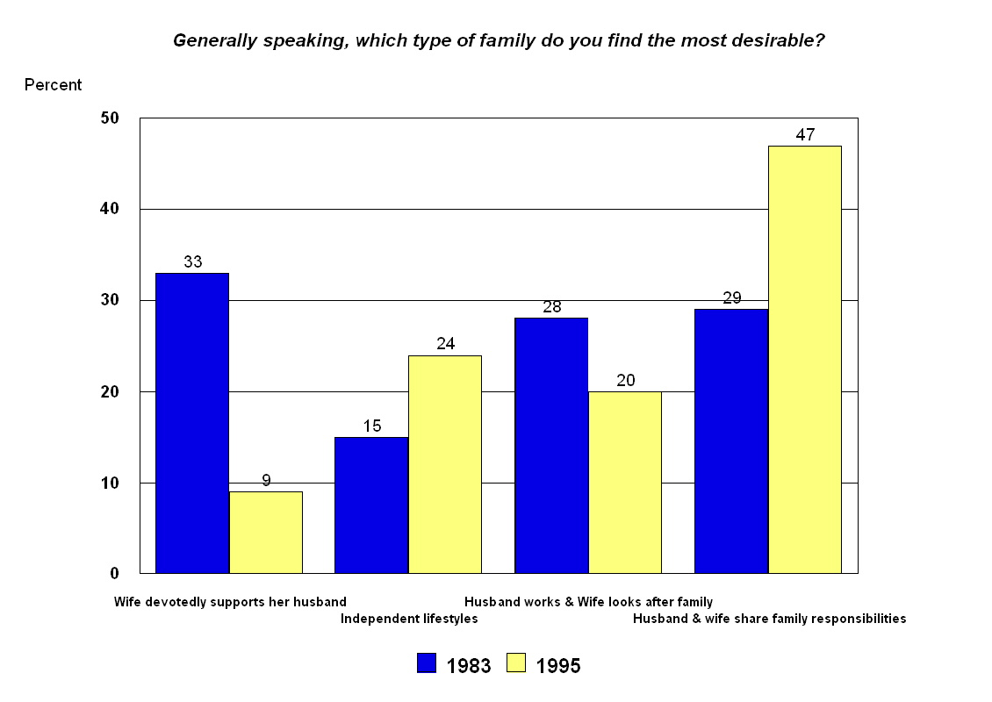
Japanese men and women’s attitudes to the family are changing – few people now want a ‘traditional’ family where the ‘wife devotedly supports her husband’

Slide 51
Reducing the cost of raising children

Slide 52
The cost of children in Japan
National Lifestyle White Paper 2005

Slide 53
Part time work is badly paid for women

Slide 54
Poorer Households (< 4 million yen) have fewer children

Slide 55
Raising Children is expensive in Japan
The financial cost of raising children is the biggest reason women give for not having more children –
78% of women under 35 and 57% of women over 35 believe that the costs of raising children and education are prohibitive.
National Lifestyle White Paper 2005

Slide 56
Poverty & Social Inclusion Policies in Japan
Without efficient and effective anti-poverty and social inclusion policies Japan may face a bleak future in the 21st Century with a rapidly declining and ageing population, increased poverty and recurring financial crises, particularly in the housing market.
Fortunately, both the public and policy makers in Japan are now beginning to support new anti-poverty and social inclusion policies.

